Slide 1
Applications of Bayesian Networks in the Age of AI
Session II: Bayes Net
Duanli Yan, Russell Almond, & Diego Zapata

Slide 2
Agenda
SESSION TOPIC PRESENTERS
Session 1: Evidence Centered Design Diego Zapata ACED introduction
Session 2: Bayes Nets and Applications Duanli Yan
Session 3: Refining Bayes Nets with Russell Almond & Data Duanli Yan
Session 4: Bayes Nets with R Russell Almond

Slide 3
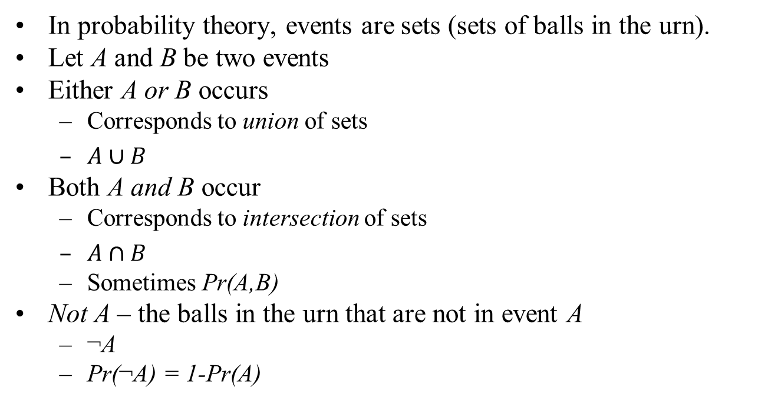
Cup and Cap notation
In probability theory, events are sets (sets of balls in the urn).
Let A and B be two events
Either A or B occurs
Corresponds to union of sets
$A∪B$
Both A and B occur
Corresponds to intersection of sets
$A∩B$
Sometimes Pr(A,B)
Not A – the balls in the urn that are not in event A
¬A
Pr(¬A) = 1-Pr(A)

Slide 4

Conditional Probability
H
¬ H
E
Definition
Law of Total Probability

Slide 5
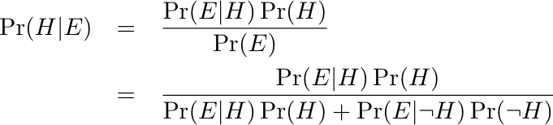



Bayes Theorem
Prior
Likelihood
Posterior

Slide 6
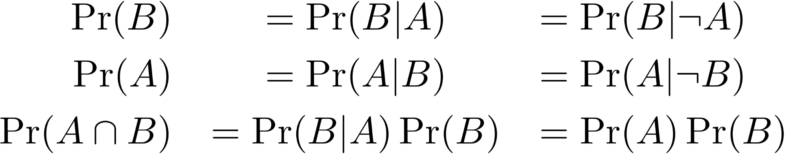
Independence
A
¬ A
B
A provides no information about B

Slide 7
Accident Proneness (Feller, 1968)
Driving Skill: 5/6 Normal, 1/6 Accident Prone
Probability of an accident in a given year
1/100 for Normal drivers
1/10 for Accident prone drivers
Accidents happen independently in each year
What is the probability a randomly chosen driver will have an accident in Year 1?
Given a driver had an accident in Year 1, what is probability of accident in Year 2?

Slide 8

Accident Proneness (cont)
What is the probability a randomly chosen driver will have an accident in Year 1? Year 2?

Slide 9
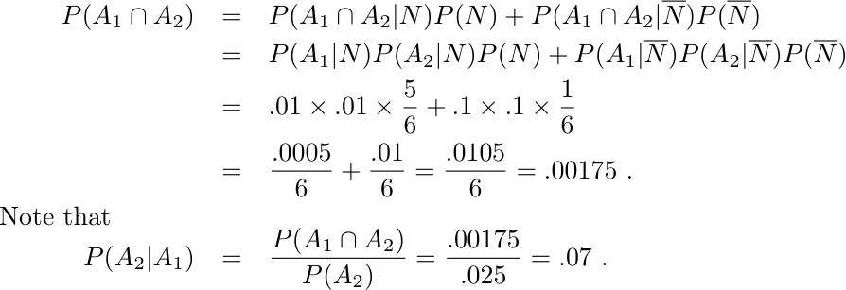
Accident Proneness (cont)
Given a driver had an accident in Year 1, what is probability of accident in Year 2?

Slide 10

Conditional Independence
Years are conditionally independent given driving skill
Years are marginally dependent
Separation in graph tells the story

Slide 11

Competing Explanations
Skill 1 and Skill 2 are (a priori) independent in population
Task X requires both skills (conjunctive model)
Answer the following questions:
What is posterior after learning X=False, and θ₁=High?
What is posterior after learning X=False, and θ₂=High?
What is true of joint posterior of θ₁ and θ₂  after learning X=False?

Slide 12

D-Separation
For ←→, →→, and ←← edges conditioning on middle variables renders outer variables independent
For →← (collider) edges, if middle variable (or descendent is known) then variables are dependent
A path is active if collider with middle node observed, or non-collider with middle node unobserved

Slide 13
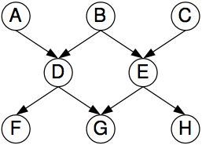
D-Separation Exercise
Are A and C independent if
We have observed no other variables?
What could we condition on to make A and C independent?
We have observed F and H?
What else could we condition on to make A and C independent?
We have observed G?
What else could we condition on to make A and C independent?

Slide 14
Building Up Complex Networks
Recursive representation of probability distributions:
All orderings are equally correct, but some are more beneficial because they capitalize on causal, dependence, time-order, or theoretical relationships that we posit: Terms simplify when there is conditional independence –
in ed measurement, due to unobservable student variables.

Slide 15
Building Up Complex Networks, cont.
For example, in IRT, item responses are conditionally independent given θ:

Slide 16
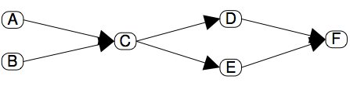
Bayes net
One factor for each node in graph in recursive representation
This factor is conditioned on parents in graph
“Prior” nodes have no parents
p(A)p(B)p(C|A,B)p(D|C)p(E|C)p(F|D,E) = p(A,B,C,D,E,F)
Digraph must be acyclic

Slide 17
Activity 2: Build a Bayes Net
Pick one of the tasks you created and build an a Bayes net in Netica:
Proficiency variables, their possible values
Observable variables, their possible values
Conditional probabilities between Proficiency variables and Observable variables
Add your observables to the proficiency model you made in Netica

Slide 18
1. Discrete Item Response Theory (IRT)
Proficiency Model
Task/Evidence Models
Assembly Model
Some Numbers

Slide 19
IRT Proficiency Model
There is one proficiency varaible, θ. (Sometimes called an “ability parameter”, but we reserve the term parameter for quantites which are not person specific.)
θ takes on values {-2, -1, 0, 1, 2} with prior probabilities of (0.1, 0.2, 0.4, 0.2, 0.1) (Triangular distribution).
Observable outcome variables are all independent given θ
Goal is to draw inferences about θ
Rank order students by θ
Classify students according to θ above or below a cut point

Slide 20
IRT Task/Evidence Model
Tasks yield an work product which can be unambiguously scored right/wrong.
Each task has a single observable outcome variable.
Tasks are often called items, although the common usage often blurs the distinction between the presentation of the item and the outcome variable.

Slide 21
IRT (Rasch) Evidence Model
Let X_{j} be observable outcome variable from Task j
P(X_{j} =right | θ, β_{j} ) =
β_{j} is the difficulty of the item.
Can crank through the formula for each of the five values of θ to get values for Conditional Probability Tables (CPT)

Slide 22
IRT Assembly Model
5 items
Increasing difficulty:
β ∈ {-1.5, -0.75, 0, 0.75, 1.5}.
Adaptive presentation of items

Slide 23
Conditional Probability Tables
θ | Prior | Item 1 | Item 2 | Item 3 | Item 4 | Item 5
-2 | 0.1 | 0.3775 | 0.2227 | 0.1192 | 0.0601 | 0.0293
-1 | 0.2 | 0.6225 | 0.4378 | 0.2689 | 0.1480 | 0.0759
0 | 0.4 | 0.8176 | 0.6792 | 0.5000 | 0.3208 | 0.1824
1 | 0.2 | 0.9241 | 0.8520 | 0.7311 | 0.5622 | 0.3775
2 | 0.1 | 0.9707 | 0.9399 | 0.8088 | 0.7773 | 0.6225

Slide 24
Problems Set 1
Assume θ =1, what is expected score (sum X_{j})
Calculate P(θ |X₁=right), E(θ |X₁=right)
Calculate P(θ |X₅=right), E(θ |X₅=right)
Score three students who have the following observable patterns (Tasks 1--5):
1,1,1,0,0
1,0,0,1,1
1,1,1,0,1
5. Suppose we have observed for a given student X₂=right and X₃=right, what is the next best item to present (hint, look for expected probabilities closest to .5,.5
6. Same thing, with X₂=right and X₃=wrong
7. Same thing, with X₂=wrong and X₃=wrong

Slide 25
2. “Context” effect --Testlets
Standard assumption of conditional independence of observable variables given Proficiency Variables
Violation
Shared stimulus
Context
Special knowledge
Shared Work Product
Sequential dependencies
Scoring Dependencies (Multi-step problem)
Testlets (Wainer & Kiely, 1987)
Violation results in overestimating the evidential value of observables for Proficiency Variables

Slide 26
“Context” effect -- Variables
Context variable – A parent variable introduced to handle conditional dependence among observables (testlet)
Consistent with Stout’s (1987) ‘essential n-dimensionality’
Wang, Bradlow & Wainer (2001) SCORIGHT program for IRT
Patz & Junker (1999) model for multiple ratings

Slide 27
“Context” effect -- example
Suppose that Items 3 and 4 share common presentation material
Example: a word problem about “Yacht racing” might use nautical jargon like “leeward” and “tacking”
People familiar with the content area would have an advantage over people unfamiliar with the content area.
Would never us this example in practice because of DIF (Differential Item Functioning)
Notes:
High-income people are more likely to be familiar with boats, therefore the context effect would be correlated with a variable irrelevant to skill being measured.

Slide 28
Adding a context variable
Group Items 3 and 4 into a single task with two observed outcome variables
Add a person-specific, task-specific latent variable called “context” with values familiar and unfamiliar
Estimates of θ will “integrate out” the context effect
Can use as a mathematical trick to force dependencies between observables.
Notes:
“integrate out” is in quotes because this integral is actually a sum.

Slide 29
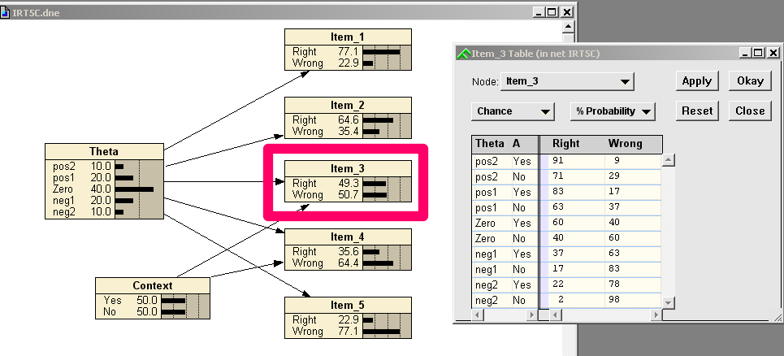
IRT Model with Context Variable
Notes:
Figure from MSBNx

Slide 30
Problem Set 2
Compare the following quantities in the context and no context models:
P(X₂), P(X₃), P(X₄)
P(θ|X₂=right), P(θ|X₃=right)
P(X₄|X₂=right), P(X₄ |X₃=right)
P(θ|X₃=wrong, X₄=wrong), P(θ|X₃=right, X₄=wrong),
P(θ|X₃=wrong, X₄=right), P(θ|X₃=right, X₄=right)

Slide 31
Context Effect Postscript
If Context effect is generally construct-irrelevant variance, if correlated with group membership this is bad (DIF)
When calibrating using 2PL IRT model, can get similar joint distribution for θ, X₃, and X₄ by decreasing the discrimination parameter

Slide 32
3. Combination Models
Consider a task which requires two Proficiencies:
Three different ways to combine those proficiencies:
Compensatory: More of Proficiency 1 compensates for less of Proficiency 2. Combination rule is sum.
Conjunctive: Both proficiencies are needed to solve the problem. Combination rule is minimum.
Disjunctive: Two proficiencies represent alternative solution paths to the problem. Combination rule is maximum.

Slide 33
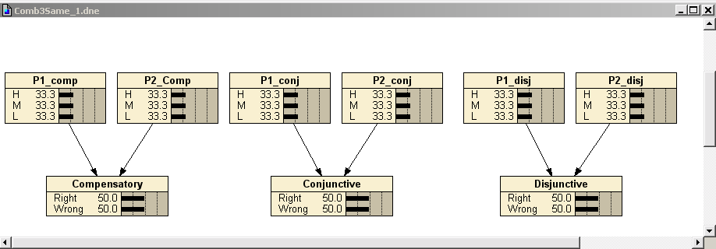
Combination Model Graphs

Slide 34
Common Setup for All Three Models
There are two parent nodes, and both parents are conditionally independent of each other. The difference among the three models lies in the third term below:
P(P₁, P₂, X) = P(P₁ ) • P(P₂ ) • P(X | P₁, P₂)
The priors for the parent nodes are the same for the three models with 0.3333 of probability at each of the H, M, and L states.
The initial marginal probability for X is the same for the three models (50/50).

Slide 35
Conditional Probability Tables
This table contains the conditional probabilities for the parent nodes (P1 and P2) and the combination model for the three models.
Table 3 – Part 2
Conditional Problems for Compensatory, Conjunctive, and Disjunctive
P1 P2 Compensatory Conjunctive Disjunctive “Right” “Right” “Right”
H H 0.9 0.9 0.7
H M 0.7 0.7 0.7
H L 0.5 0.3 0.7
M H 0.7 0.7 0.7
M M 0.5 0.7 0.3
M L 0.3 0.3 0.3
L H 0.5 0.3 0.7
L M 0.3 0.3 0.3
L L 0.1 0.3 0.1
Notes:
These three models have exactly same priors, but different conditional probabilities for the combination nodes reflecting their relationship with their parents.
Cond prob are scaled to between 0 and 1.

Slide 36
Problem Set 3
Verify that P(P₁), P(P₂), and P(Obs) are the same for all three models. (Obs represents either the node Compensatory, Conjunctive, or Disjunctive )
Assume Obs=right, Calculate P(P₁) and P(P₂) for all three models.
Assume Obs=wrong, Calculate P(P₁) and P(P₂) for all three models.
Assume Obs=right, and P₁ = H. Calculate P(P₂) for all three models.
Assume Obs=right, and P₁ = M. Calculate P(P₂) for all three models.
Assume Obs=right, and P₁ = L. Calculate P(P₂) for all three models.
Explain the differences

Slide 37
Activity 3
Go back to the Driver’s License Exam you built in Session I and add some numbers
Now put in some observed outcomes
How did the probabilities change?
Is that about what you expected?

